Slide 1

J K K NATTRAJA COLLEGE OF ENGINEERING AND TECHNOLOGY
Team Members:
Kabilan.B
Nisanth.V
Sakthivel.S
Vimal.D
Surya.R
Mentor:
MURUGASHANKAR S AP/IT
Domain : Applied Data Science
Title : Covid-19 Vaccines Analysis

Slide 2
Abstraction:
The "Covid-19 Vaccines Analysis" project conducts a comprehensive investigation into COVID-19 vaccines, examining their development, efficacy, safety, global distribution, and impact, serving as a valuable resource for stakeholders and the public to understand the ongoing vaccination efforts against the pandemic.

Slide 3

Description:
The "Covid-19 Vaccines Analysis" project is a comprehensive examination of the various vaccines developed to combat the COVID-19 pandemic. In response to the global health crisis, numerous vaccines were rapidly developed and deployed to mitigate the spread of the virus and reduce its impact on public health. This project aims to provide a detailed analysis of these vaccines, encompassing a wide range of aspects, including their development, efficacy, safety, distribution, and global impact.

Slide 4
About_Project
Sources:
Dataset: COVID-19 in India form Kaggle
In this project we perform a load the data into pandas and preprocessing then other actions.

Slide 5
Data Preprocessing:
Clean the data: Address missing values, remove duplicates, and correct any errors in the dataset.
Transform the data: Convert data into a format suitable for analysis, such as date formatting, data type conversions, and data aggregation.

Slide 6
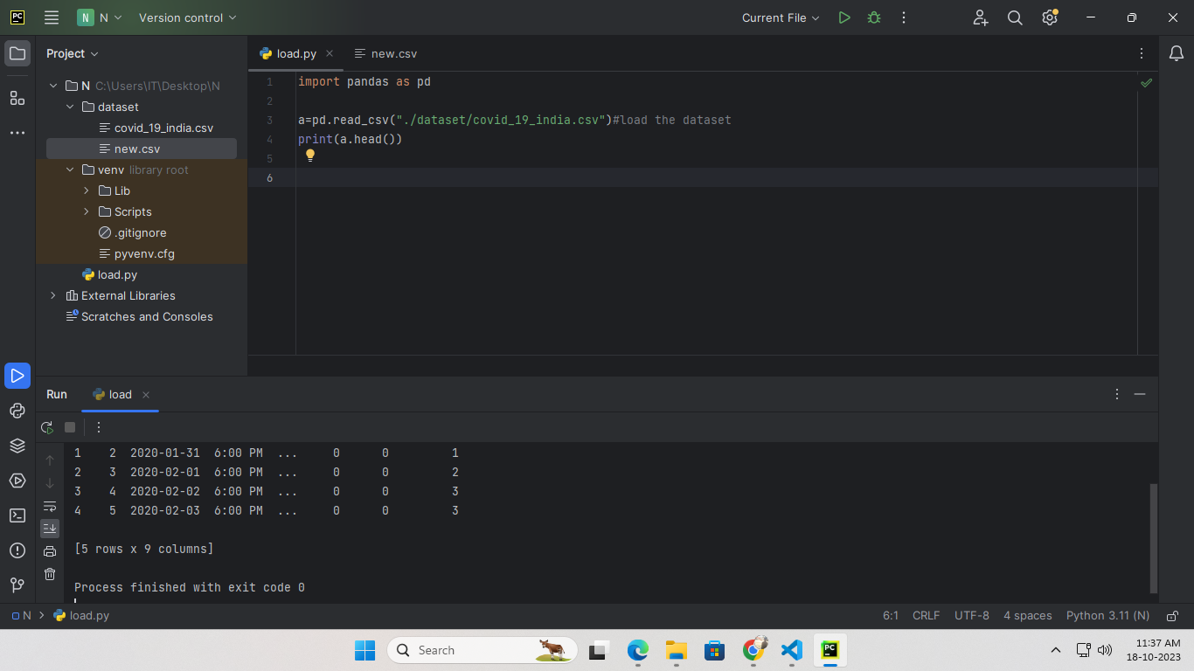
CODE:
Importing pandas and loading the dataset

Slide 7
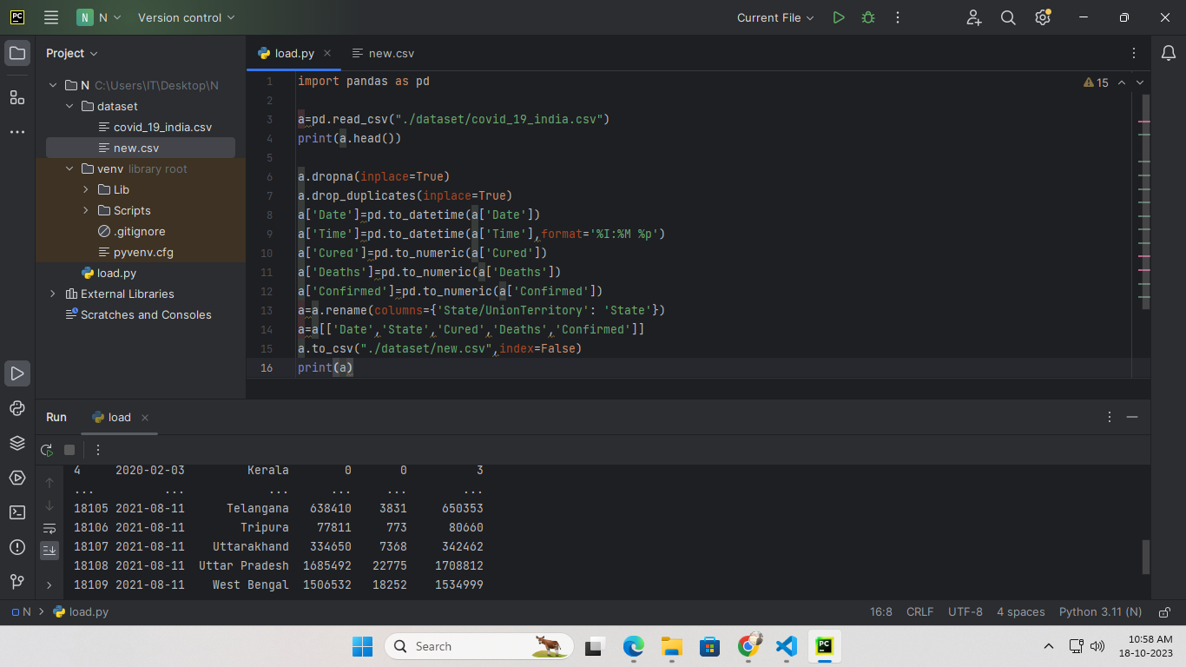
CODE:
Preprocessing the data and analysis

Slide 8
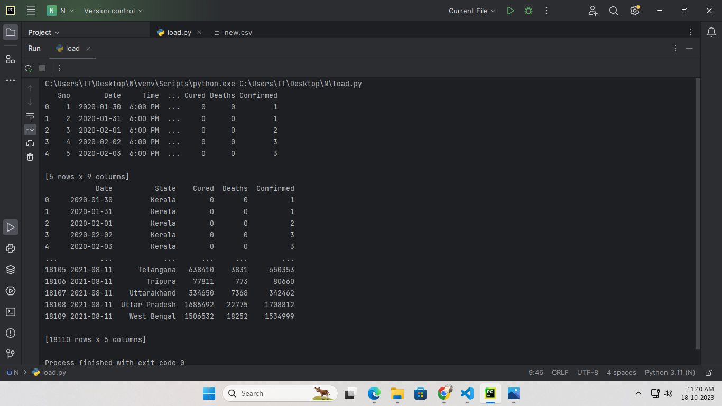
OUTPUT:

Slide 9
THANK YOU.

